Slide 1
SQL SERVER

Slide 2
Database:
A database is a structured collection of data that is stored and organized in a specific way, allowing for efficient search and retrieval of the information.
It can be thought of as an electronic filing system, where data is stored in tables with rows and columns.
The data can be easily accessed, managed, and updated by users and applications using a database management system (DBMS).
in general 3 types of databases are there
local databases----ms-access,dbase,foxpro
remote databases---sql server,oracle
3.online or internet databases---OLAP(online analytical processing),OLTP(online transaction processing)

Slide 3
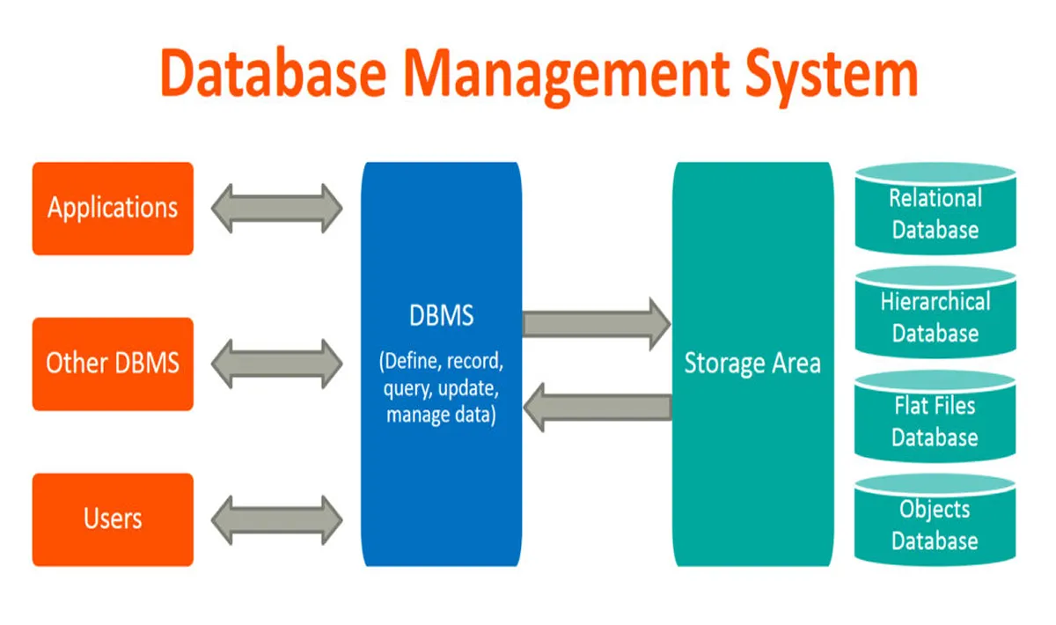
DBMS
A DBMS (Database Management System) is software that manages and organizes data stored in a database.
It allows users to create, read, update, and delete data in the database, as well as perform various other tasks such as controlling access to the data, enforcing data integrity, and maintaining data consistency.
Some examples of DBMS include MySQL, Oracle, and Microsoft SQL Server.

Slide 4
sql server:
sql server is a relational database management system which is used to manage and access the data from database.
Types of services:
database engine: is used to manage and access the data from database
analysis service: this service can be used for data warehousing concepts
reporting service: can be used to generate reports from database
integration service: it can be used to convert from one relational database
tables to another.
sql server compact edition: it can be used for mobile application development

Slide 5
Sql server download and Install
Download link sql server click here
Download SSMS click here

Slide 6
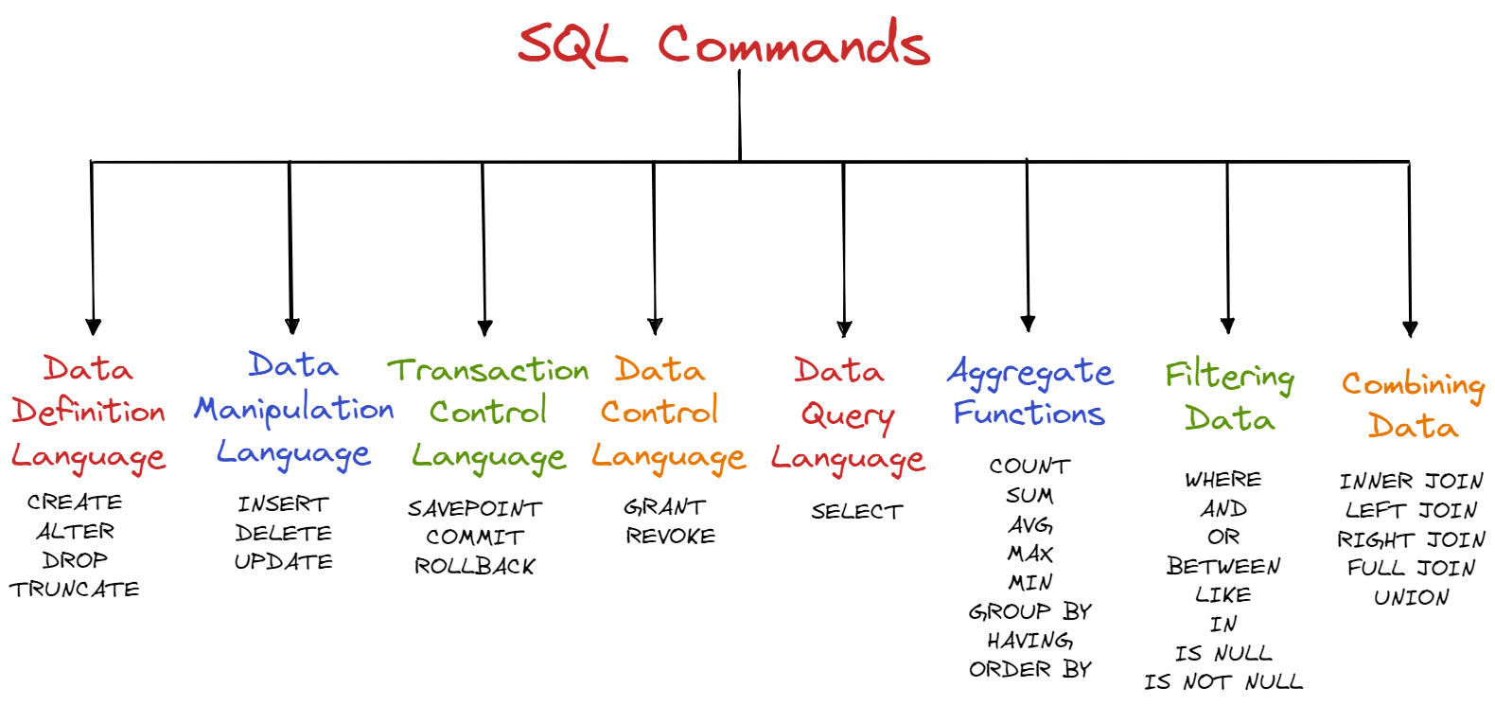
SQL(Structured Query Language):

